Slide 1
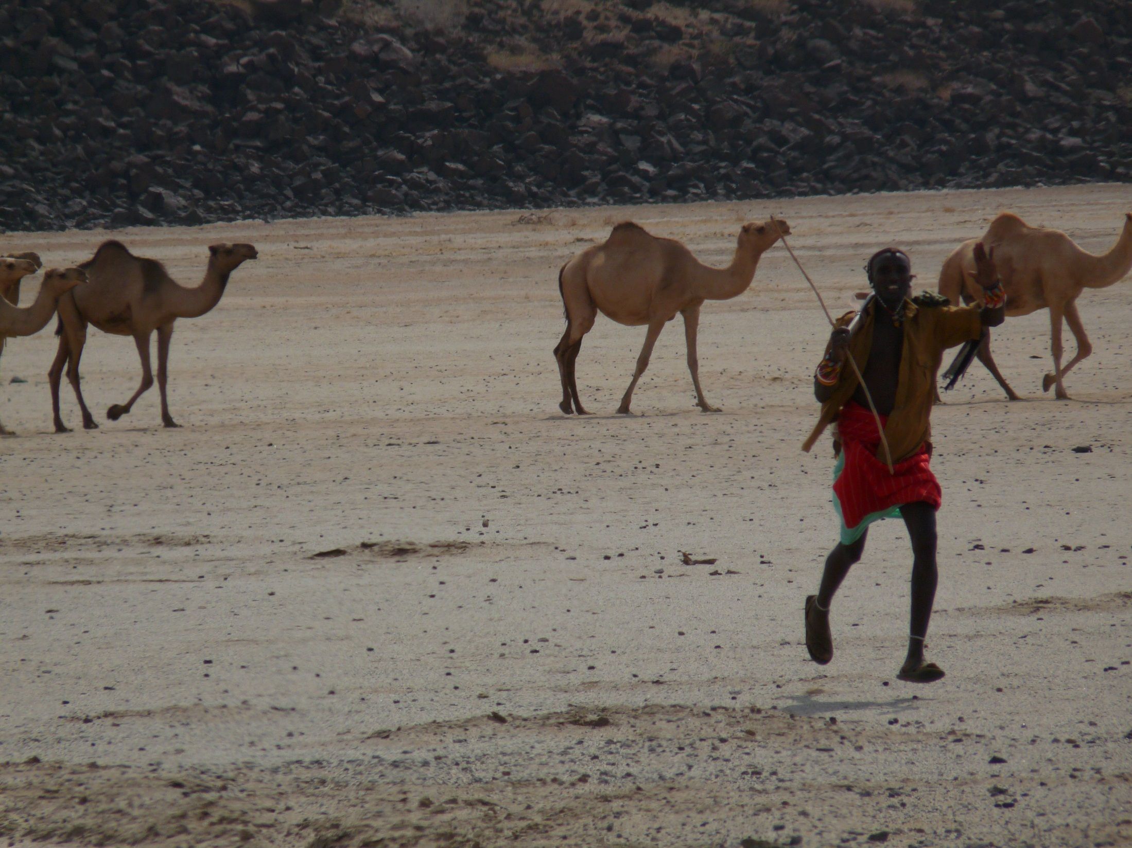

Risk Management to Escape Poverty Traps
Prof. Chris Barrett
Dyson School/Brooks School
Cornell Reunions alumni seminar
June 5, 2026

Slide 2

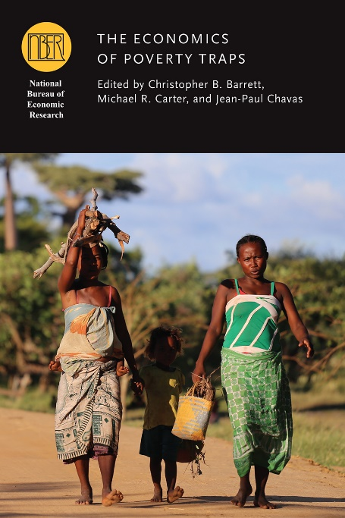
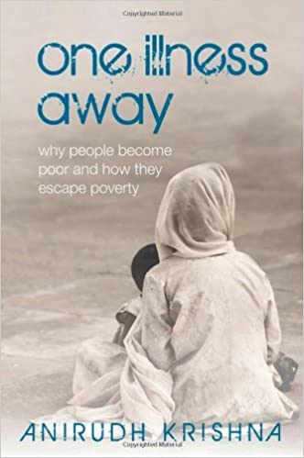
The poorest places are defined not only by the depth and prevalence of poverty but equally by poverty’s persistence. A poverty trap?
An emergent view of poverty traps emphasizes uninsured risk exposure as a key cause.
The possibility of risk-based poverty traps puts a premium on risk reduction and risk transfer tools.

Slide 3
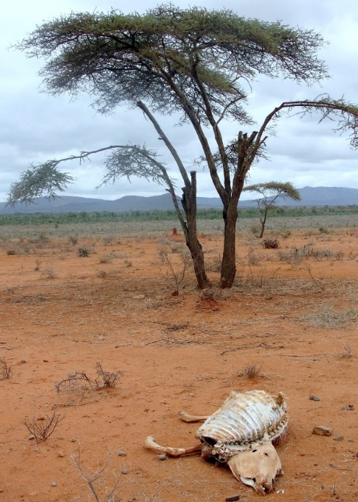
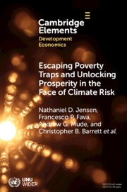
Risk transfer among east African pastoralists
Poverty traps in Kenya/Ethiopia rangelands due to catastrophic herd loss risk from major droughts.
So Cornell + partners designed and launched index-based livestock insurance (IBLI) in 2010. Early use of satellite remote sensing to price risk to leverage reinsurance industry to transfer African drought risk into global capital markets.
Very favorable impacts across multiple metrics and time scales (immediate to 10-year), with policy impacts across Africa. Now in 4 countries, >5 mn insured pastoralists, plus gov’t sovereign risk.

Slide 4
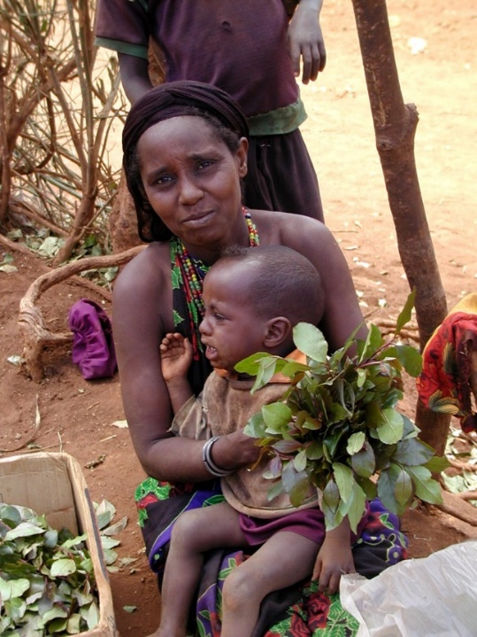
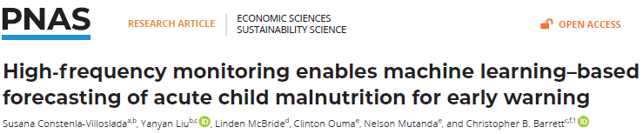
Anticipatory transfers to avert child malnutrition
Develop early warning/targeting tools to enable low-cost, fast, high-impact response to shocks.
Child GAM forecasting in Kenya w/NDMA:
NDMA pilot uses forecasts to trigger anticipatory mobile money transfers to mothers based on forecast triggers. ~$42/month reduces GAM prevalence ~9pp (vs. ~13 pp. synthetic control)

Slide 5
Reducing infectious disease risk
Schistosomiasis/bilharzia affects >240mn globally (>800 mn at risk) in poor areas. Suppresses immunoresponse. Especially harmful for children/women.
Usual response: MDA (praziquantel) but high reinfection rates. Must tackle the environmental reservoir of the disease.
Poverty-disease trap: Impedes child cognitive/physical dev’t via anemia, morbidity. Disrupts work/school attendance, lowers incomes, increasing reliance on contaminated water sources.

Slide 6
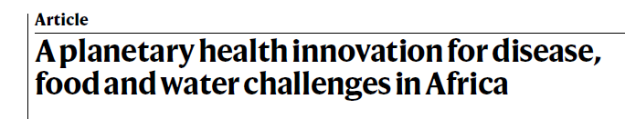
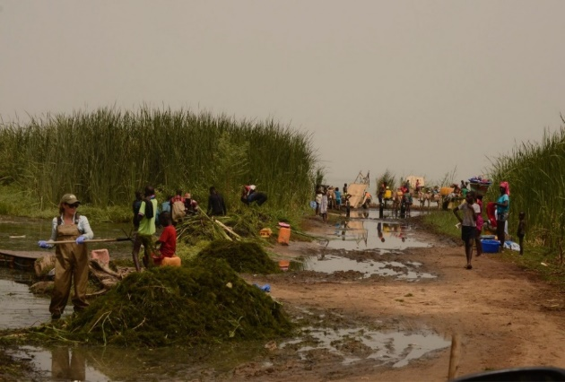
Reducing infectious disease risk
Multi-pronged approach:
(1) Clear water access points of snails’ preferred habitat, the invasive, submerged weed Cerato. Demersum. Make compost (B/C: 2.8 - 7.1) or low cost livestock feed.
2024 Frontiers Plant Prize global champion!
(2) Introduce fish to irrigated rice fields to compete with (tilapia) or prey on (African bonytongue) snails and boost crop productivity.
(3) About to start stage 3 livestock vaccine trials. Cattle and human forms hybridized(!) and migrating cattle contaminate water points and irrigated fields.

Slide 7
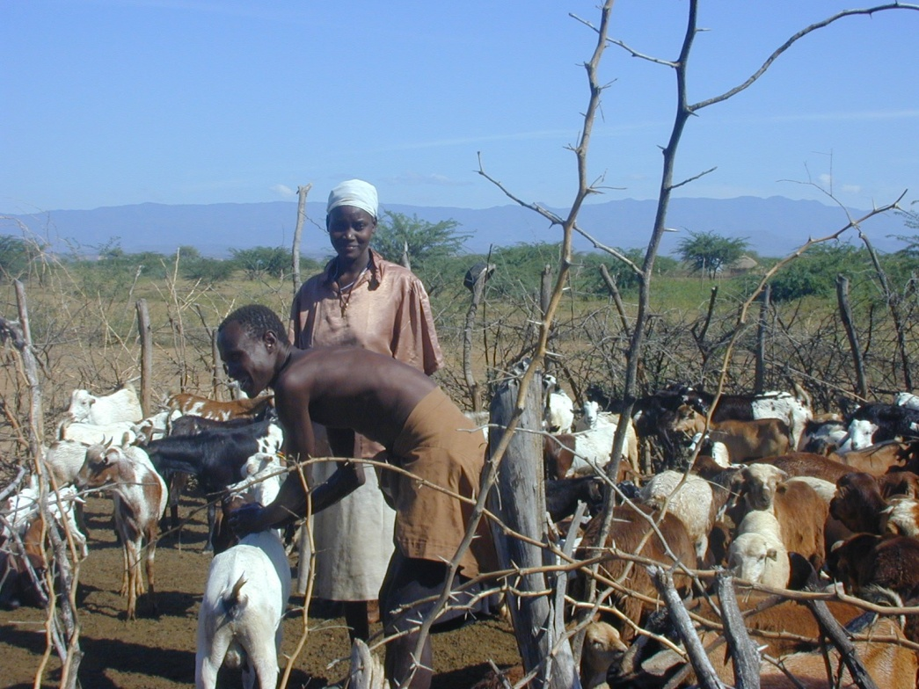
We strive to better understand how to reduce/ transfer risks to help people escape poverty.
Thank you for your time and interest!
Notes:
7

